Slide 1
Attendance Management System
Team Nexus| Hackathon IOT
April 17, 2018

Slide 2
Problem
Teacher’s time in Admin work
Manual/ Batch Processing of Timecard data/ student/Employee attendance
Third party systems process employee/student timecard data in batch to the ERP system.

Slide 3
Solution
Reduce the teacher time in admin work
“Cost Effective"/ “Smart“ solution using smart devices integration to eliminate the need to manual attendance tracking/ third party time tracking systems

Slide 4
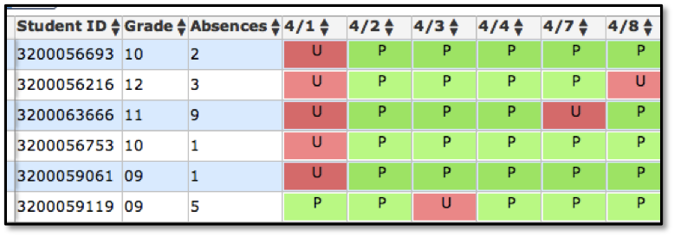
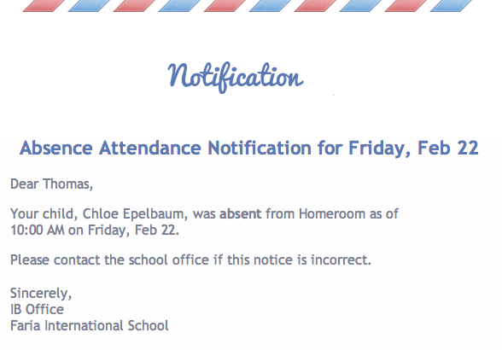
What we Achieve

Slide 5
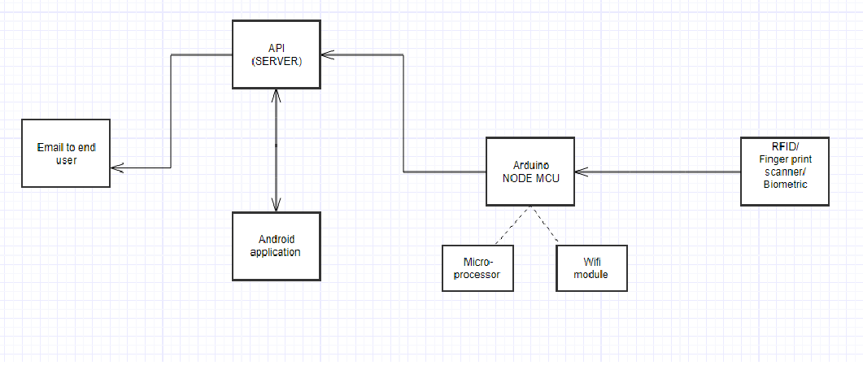
Block Diagram

Slide 6
Future Enhancements
Similar setup can be used to Automate schools with Customization, Used in School Library for Book Tracking and Catalogue Information
Ease school administrator to automate temperature control/ alarms/ class scheduling/ lighting ..resulting in energy saving.
Integration to Analytics sever, can provide real time insights on student attendance.
Based on student count , school Meal logistics can be arranged.
Empower schools , enable them become smarter using cost effective smart devices.
Using Attendance App Parents can track their ward.

Slide 7
Q&A

